Slide 1
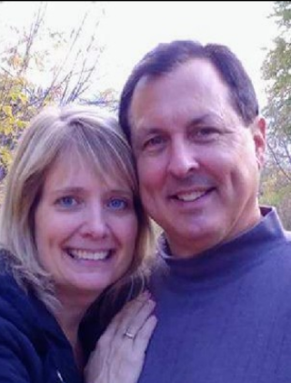
Mrs. Shawn Bennison
The Basics!
I would like to take a moment and introduce myself. My name is Shawn Bennison. I have taught at Monte Cristo Elementary for 14 years. In those twelve years I have taught 1st grade, ECEAP Preschool, and 3rd grade. I have been married for 34 years to my husband, Scott. We have a 26 year old son, Weston and a 24 year old daughter, Laura. On my off time, I like to spend time with my family, friends, and time on our boat. I am very excited to have your child this year and look forward to getting to know your family.
MY EDUCATION!
I grew up in Snohomish and graduated in 1984 from SHS. After having a photography business with my husband, I went back to school in 2002 to follow my dream of teaching. I graduated from Western Washington University in 2005. My future goal is to go back to receive my Masters in Education in the next few years.
MY FAVORITES!
Food: Pizza
Movie: Momma Mia
Book: Little House on the Prairie
Color: Pink
Drink: Diet Pepsi
Season: Spring
Sports: Football
Fast Food: Taco Time
Singer: Chris Tomlin
Hobby: Walking
Subject: Math
Store: Target
Dessert: Blackberry pie
Candy: Payday
Restaurant: Red Robin
Flower: Roses
CONTACT ME!
Email: sbennison@gfalls.wednet.edu
Class Phone Number: ((360) 2834425
You can also write a note in your child’s daily schedule.

